Slide 1
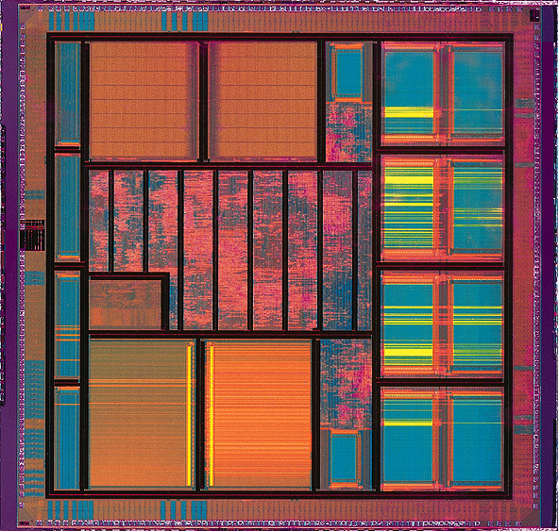
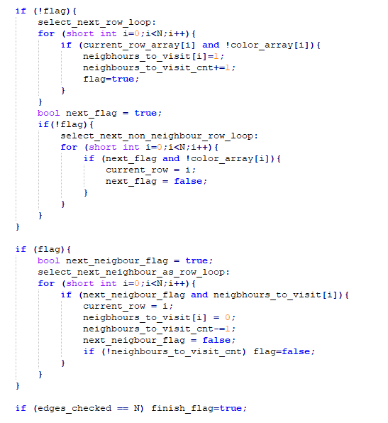
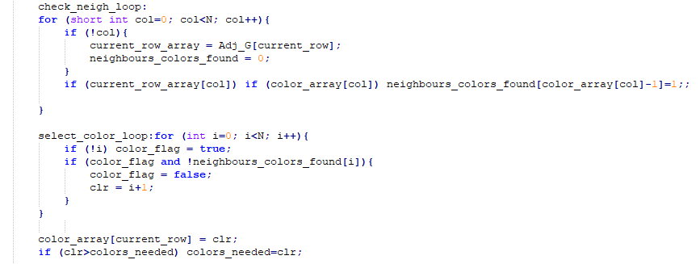
High Level Synthesis Lab
Task E
Implemented Algorithm
Step 1: Read neighbours of 1st edge from table (memory) and store it locally.
Step 2: Check each neighbour for having a colour assigned to it. Assign
the lowest colour number not found in any neighbour to current edge. If new colour number was assigned, increase the required graph colours by 1.
Step 3: Having saved each neighbour from step 2, select the first neighbour saved to read as next memory and repeat step 2 until all neighbours from 1st edge are checked. If all neighbours are checked, read the second edge not already checked from memory (if only one is available, read that one). Repeat steps 2 and 3 until all edges have a colour assigned.
Graphs Tested:
Add not-coloured neighbours as next rows
Check for coloured neighbours
If none select next row available to proceed.
Pick first colour not found in neighbours
Select next neighbour to read
+1 for colours needed if new colour picked

Slide 2
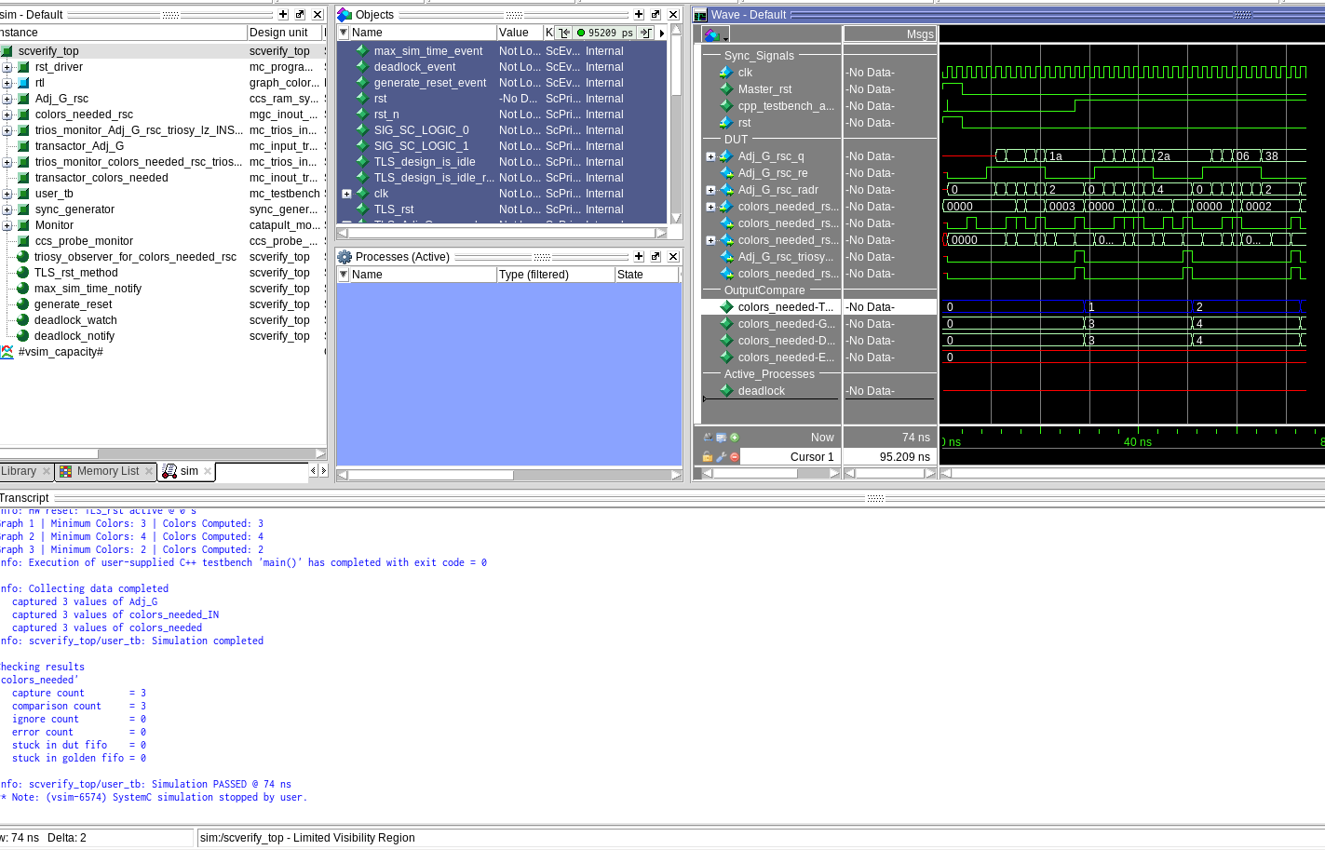
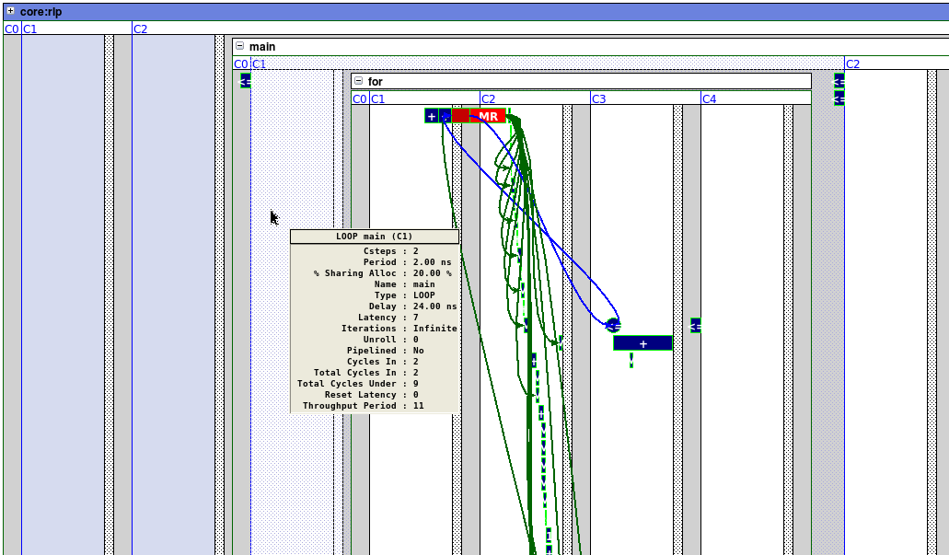
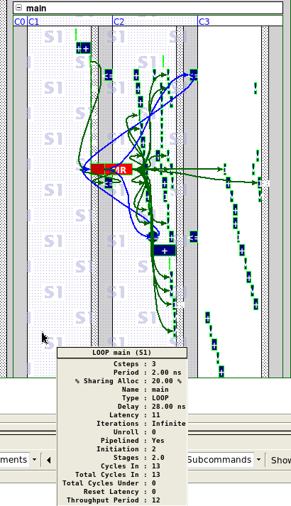
High Level Synthesis Lab
Task E
Pipelined whole module with II=2 (Thgroughput achieved: 11).
All loops inside main ‘for’ loop are fully unrolled.
Pipelined main loop only
with II=1 (Throughput
achieved: 12).
Again, all loops inside main
‘for’ loop are fully unrolled.

